Slide 1
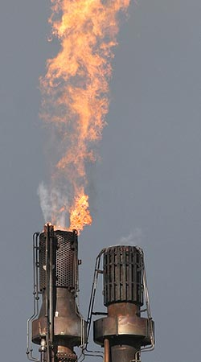
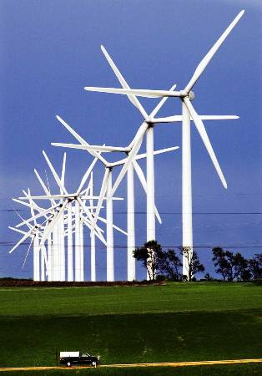
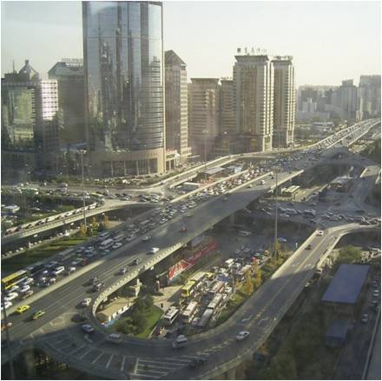
Regional Programms Climate Change Mitigation
Alexandra Soezer
Carbon Technical Advisor
alexandra.soezer@undp.org
Bonn, March 24th 2012

Slide 2
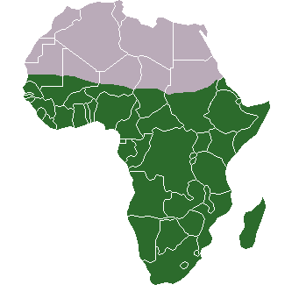
African Climate change work
Outcome 1: African countries informed, prepared and effectively participate in climate change negotiations
Activities:
Skills-building and training-of-trainers workshops for key African negotiators and selected regional institutions;
Undertake analysis in selected West African countries on capacity development needs for the enabling activities related to mitigation;
Regional Environment Project

Slide 3
African Climate Change Work
Outcome 2: Capacities of Designated National Authorities (DNA) strengthened in countries with less than 10 registered projects, with CDM projects in the pipeline or under development;
Activities:
Facilitate exchange tours and study visits among DNAs:
-West and Central Africa: RE study tour
-East and South Africa: Charcoal study tour
Operationalise the web-based Africa CDM online platform ;
Regional Environment Project

Slide 4
African Climate Change Work
Outcome 3: Encourage off-take of PoAs in Africa;
Activities:
PoA workshop for stakeholders in LDCs; Focus: Learning from experiences key sectors: solar water heating, cooking stoves, EE lighting Target group: Project developers, DNAs, potential CMEs
Regional CME (Coordinating/Managing Entity ) trainings jointly organised by UNDP and UNFCCC ;
Focus: Train potential entities about latest approved standards and procedures for PoAs;
Regional Environment Project

Slide 5
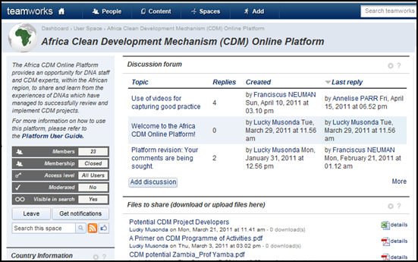
Africa CDM Online Platform ... for DNA staff and CDM experts, within the African region, to share and learn from the experiences of DNAs which have managed to successfully implement CDM projects
Regional Environment Project

Slide 6
Africa CDM Online Platform
Objectives:
Strengthen capacity of DNAs so as to create the enabling conditions for CDM project development;
Raise awareness within governments on CDM and its potential in promoting sustainable development;
Promote broader understanding of CDM projects among CDM stakeholders;
Promote peer to peer learning through sharing of experiences and good practices.;
Countries on platform to date:
Morocco, Nigeria, Angola, Cote D’Ivoire, Rwanda, South Africa, Swaziland
Regional Environment Project

Slide 7
UNDP Regional Program for LAC
“Evolving in line with the necessities”
2008
2009
2010
2011
2012
Carbon 2012 Project
Climate Policy 2012 Project
Global Project: Capacity Development for Policy Makers to Address Climate Change
Low Emission Capacity Building global programme EU/UNDP/Germany/Spain (LECRDS)
Scaled-up mitigation mechanisms
Low emissions cities
Support programme for the preparation of low-emission development strategies adapted to CC at a sub-national level (LECRDS/TACC)
Support programme for LECRDS preparation at the national level
Notes:
Donantes 2008-2011:
España
Reino Unido (Impacto Social)
Proyecto Global Rebecca (Finlandia, Noruega y Suiza)
PNUD
Donantes 2011-2012:
España
UE
Alemania
PNUD

Slide 8
UNDP Regional Program for LAC
Carbon 2012 Progarmme
Objective: Promoting a transition towards low emission and climate resilent development through the access and efficient use of carbon finance.
Activities:
Enhance capacity to identify, design and implement ER projects & programmes;
Strengthen capacities of DNA;
Promote investment in ER projects and programmes;
Promote inter-agency cooperation (within the United Nations) and dissemination of information, knowledge, education and training - UNEP;
Notes:
Financiado por el Gobierno de España
Se presentará en este evento como estudio de caso un programa de actividad MDL de cocinas ahorradoras de leña que ha sido apoyado por el proyecto Carbono 2012 en El Salvador.
Costa Rica, Cuba, El Salvador, Honduras, República Dominicana, Perú, Uruguay

Slide 9
UNDP Regional Program for LAC
Carbon 2012 main results
Completed feasibility studies to remove barriers to development of CDM projects: Belize, Peru, Dominican Republic, Uruguay, Cuba and El Salvador.
Costa Rica
Preparatory activities for the establishment of a domestic voluntary carbon market;
Dominican Republic
Support design of the National Carbon and Climate Change Fund;
Cuba
Support to the Cuban Technical Office for the Implementation of CDM projects and for the promotion of financing and technology transfer ;

Slide 10
UNDP Regional Program for CC
Carbon 2012 main results
El Salvador
Supported the “Turbococinas” PoA for the replacement of rural stoves; first stoves programme to be registered under the CDM in LAC;
supported the restructuring of the National Environmental Fund (FONAM) to improve access to international climate funds;
Peru
Study for the preparation of National Appropriate Mitigation Action in energy efficiency (NAMA);
Facilitated the access to the improved stoves project “NINA” of the Government;
Uruguay
Carbon footprints for product chain of export products;

Slide 11
UNDP Regional Programs for CC
Thank you!

