Slide 1
“Idling Stop Device Introductions to the Buses of Jinan Public Transport Group Company in Jinan City, China” based on AMS III.AP.
ALMEC Corporation
Yajima Mitsuro
Practitioner Workshop on the Improvement of CDM
Methodologies for Transportation
3rd March 2011, Wissenschaftszentrum Bonn Ahrstr. 45, Bonn, Germany

Slide 2
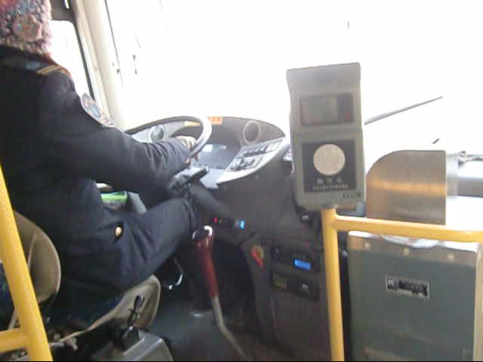
Video for Idling stop operation

Slide 3
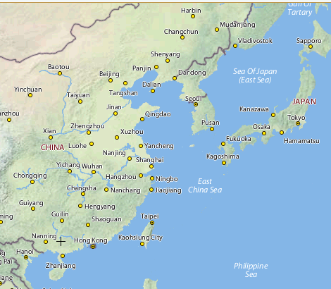
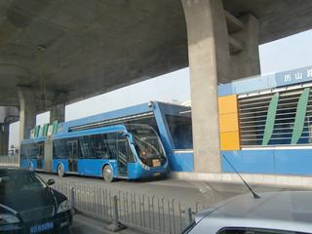
OuTline of JPTC
Jinan,Shandong,China
Population 3million
(Urban agglomeration)
No UMRT but 6 BRT lines
Jinan Public Transport Group Company(Jinan Bus)
Employee 11,000 persons
Bus Vehicle 4,000 nos.
Daily pax 2.2million
Route 188 lines

Slide 4
ProfiLe of Study
2008/June First Idling-Stop Device installation in WB Study “Guidelines for Preliminary Estimations of Carbon Emissions Reductions in Urban Transport Project”
2009・2010 CDM Project Feasibility Study on “Energy Efficiency Activities Using Idling Stop Equipments for Buses in JPTC” supporting with MOEJ(Ministry of Environment Japan) and MOEJ supported GEC(Global Environment Centre Foundation)
2010/Nov Small-Scale new methodology (ASM Ⅲ-A.P.) approved. (2011/02 ver.2 approved)
Total 11 nos. of devices are installed to the Jinan buses in the Study and evaluated

Slide 5
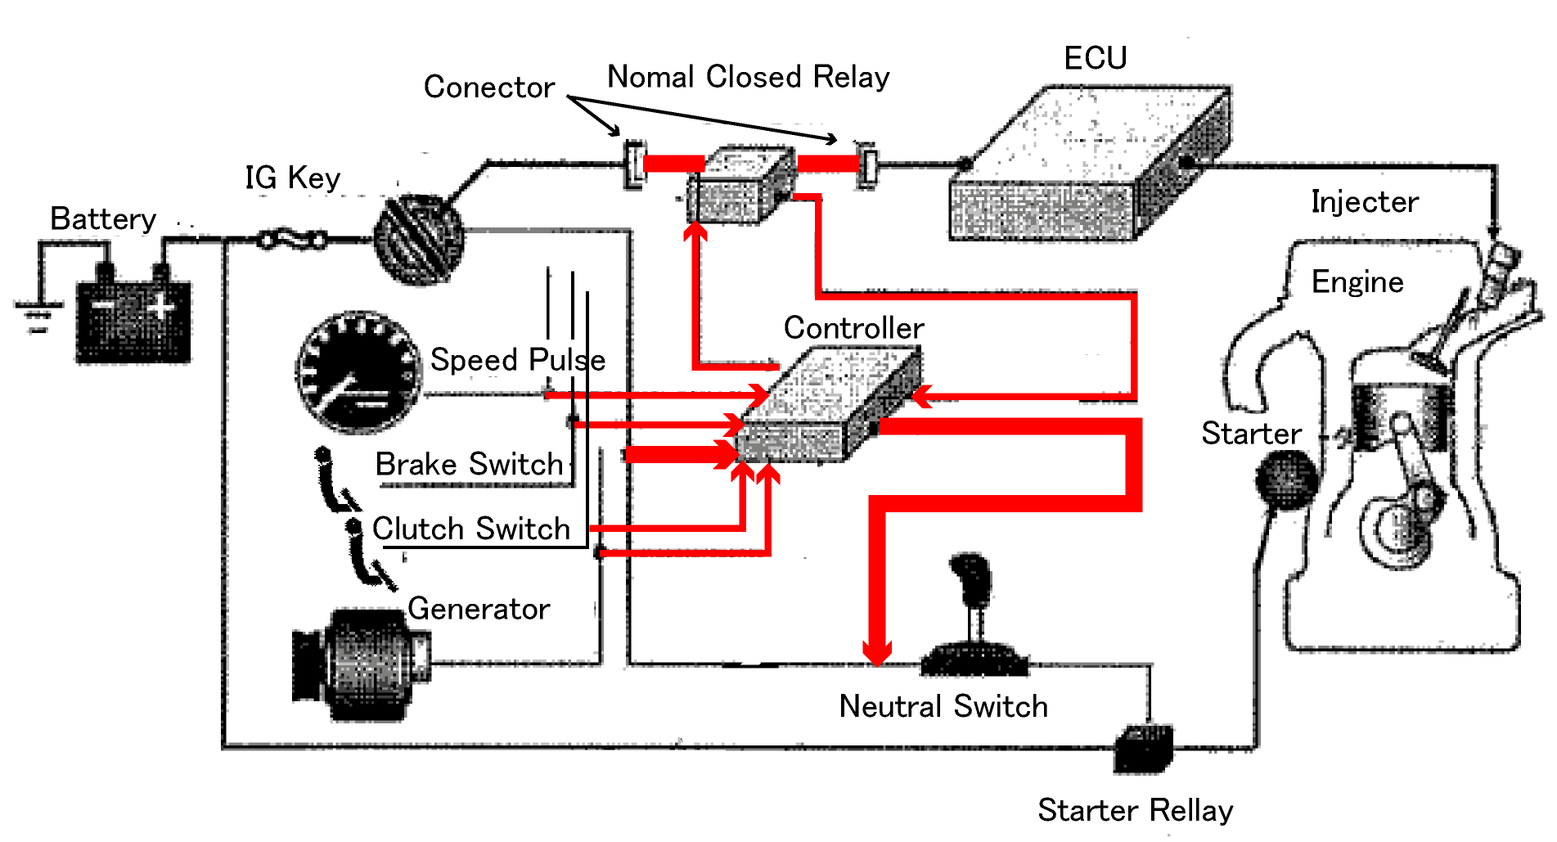
Technology/measure
When the following status of vehicle operations are recognized, the controller output signals to ignition circuit.
In case of MT vehicle
Engine Cut
Stop(Velocity=0)
Foot brake On
Shift position neutral
+ clutch connect
(or push stop button)
Engine Restart
Foot brake On
Shift position neutral
+ clutch disconnect

Slide 6
Applicability
Applicable to 1400 nos. of total 4000 nos. of Jinan buses.
Exclude CNG, Hybrid, Euro II class, trolley buses
Issue: To widen the applicability
CNG, Lorry, Taxi, Private car,
Diesel Locomotives, Ships, compressor...
Issue: Possibility to include manual idling-stops using ignition key only. (equipping idling-stop support and monitoring device)

Slide 7
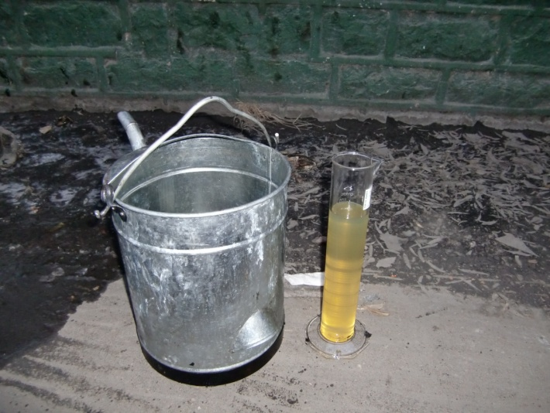
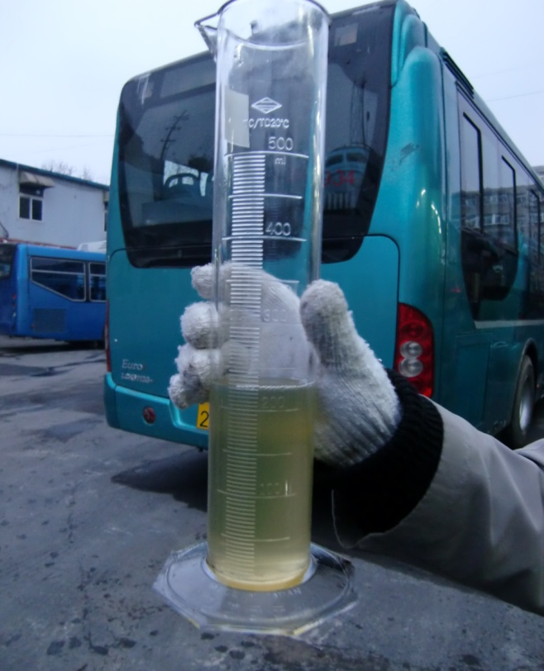
Baseline(1)
Measurement method of Fuel Consumption Rate at Idling
1) Filling up tank(180L)
easy but inaccuracy (300cc/10min)
2) Hydraulic meter
expensive and take much labor
3) Estimate from OBD2 signal
correction factor required
practical

Slide 8
Baseline(2)
Vehicle Stopping ratio: 30% of Vehicle Operation Time
Average Idling-stop ratio: 8% (Max.13%) of VOT
A Idling-stop in every 8 times of stop equivalent to 46 % of total stopping time (14% of VOT).
40 seconds
period
times

Slide 9
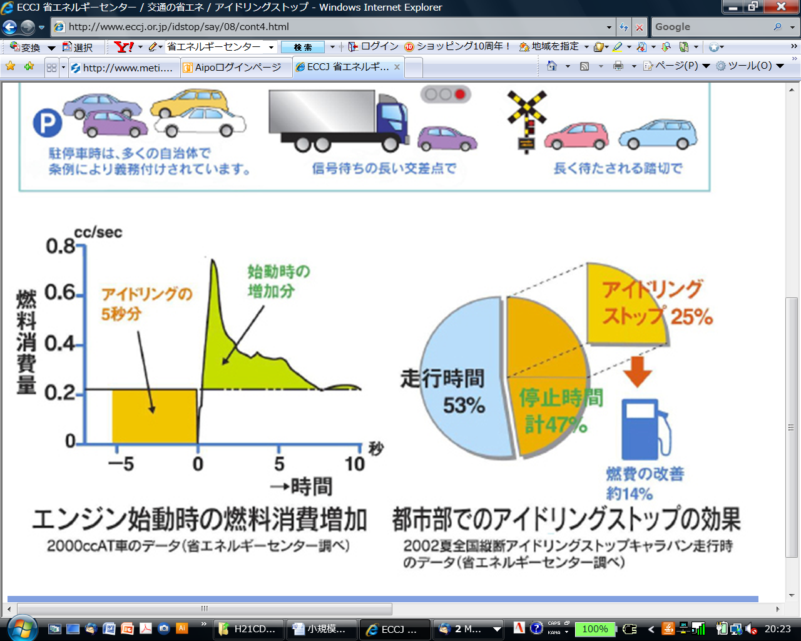
Project activity emissions
Experiences in Japan
・Fuel Consumption Rate (FCR) in idling (500rpm)
= 24-30cc/min（0.4-0.5cc/sec）
・Extra FCR of Engine restart
= around 2cc／time
・Start up compensation time
= 2cc／ 0.4-0.5cc /sec
= 4-5sec
・idling-stop not exceeding 5 seconds worsen the fuel economy
Necessary to stock the data for compensation time of buses
Extra Fuel Consumption at engine restart
5 seconds in Idling
ASM III.AP.
10 seconds
FCR
Extra fuel consumption at engine restart
(Example: 2000cc AT car)

Slide 10
Emission Reduction (Business PLAN)
Number of buses device equipped: 1400 nos.
Idling Stop Ratio to VOT : 10%
Annual operation time: 4000 hours
Saving Fuel Consumption : 942KL/year
CO2 Emission Reduction: 2,450 tCO2/year
Benefit valued in money
Energy Efficiency: USD1.0 million/year
Global Warming: USD0.04million/year

Slide 11
Monitoring
Cumulative Idling Period : CIP
Total number of times of Idling Stop: NT
Controller is checking the status of vehicle operation. Once the event (break a status) happen, data logger record it.
Only vehicle stoppages up to a maximum of three minutes qualify and longer duration stoppages (e.g. at the depot, or fueling stops) are excluded.
GPS data required to exclude IS in depot ?
Monthly monitoring for 1400 nos. of buses cost too much

Slide 12
Project FEASIBILITY
EE Project Business Plan
(unit: x1000USD)
(1)Energy Efiiciency (EE)
(2) CDM
(3)Extra for CDM
Economic Evaluation
No
E
Cost | Benefit | B/C
1,500 | 10,500 | 7
Yes
CDM Project Business Plan
Cost | Benefit | B/C
2,200 | 10,800 | 5
Extra C&B for CDM to EE
Economic Evaluation
Cost | Benefit | B/C
700 | 300 | 0.4
Yes
No
CDM
Energy Efficiency

Slide 13
To Promote Idling-stop CDM project
Widening applicable Vehicle category
( To Reduce Project Cost)
Reduce monitoring cost and device cost
Possibility to qualify manual Idling-stop using only ignition key as CDM
( To Increase Benefit)
Extension to Eco-Drive
Idling-stop is one of 4 Eco-drive modes.

Slide 14
Thank you for your attention!
Almec Corporation
Yajima Mitsuro
yajima@almec.co.jp

