Slide 1
CDM Programme of Activities (PoA)
Challenges and Solutions
Experience from the –
UNFCCC registered PoA “Bachat Lamp Yojana”
Bureau of Energy Efficiency
Indo-German Energy Programme

Slide 2
Overview: Bachat Lamp Yojana (BLY)
Objectives
Scheme Architecture
Learning's

Slide 3
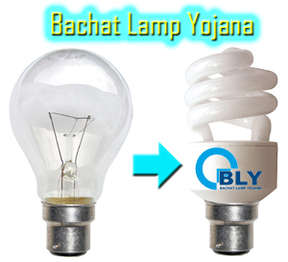
BLY PoA Objective
Driver
Reduce cost of CFLs using CDM revenue for domestic users; and
hasten Market Transformation to energy efficient lighting
Scheme Objective
Potential Benefit by 2020
0.5 million light-points per project, > 400 projects possible to cover India
Avoided capacity ~ 4000 MW
Worlds largest registered PoA by population coverage
Promotes policy for energy efficient lighting
in households –
CFL market price $ 2 – 2.5;
under BLY $ 0.30

Slide 4
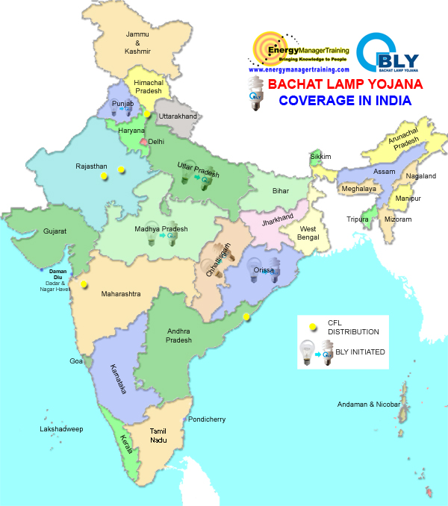
Current Status*
Geographic Coverage
State | Status
CPAs Included
Current | 2
By May 2011 | 28
Empanelled Investors
Overall | 21
Active | 8
Investment Outlay
Per CPA | $ 1.13 million
CFLs Distributed
In millions | ~ 10
* As of today
Notes:
MW savings potential-
82 W savings per CFL, 200 million light points means 16400 MW. Assuming only 25% potential is achieved 4200 MW.
18 W CFL = 100 W incandescent bulb i.e saving per lamp is 82 W (Max replaceable lamps to qualify under small scale 60 GWh is 5.04 Lakh CFLs)
Assuming 3.5 hour usage/ day, in a year per CFL i.e total of 1277.5 hour use
energy saving will be = 82 x 1277.5 = 104.8 KWhr / year and taking Emission factor as 0.85 tCO2/ GWhr
0.09 tCO2 / CFL / year
14 W CFL = 60 W incandescent bulb i.e saving per lamp is 46 W (Max replaceable lamps to qualify under small scale 60 GWh is 8.93 Lakh CFLs)
Assuming 4 hour usage/ day, in a year per CFL i.e total of 1277.5 hour use
energy saving will be = 46 x 1277.5 = 58.77 KWhr / year and taking Emission factor as 0.85 tCO2/ GWhr
0.050 tCO2 / CFL / year

Slide 5
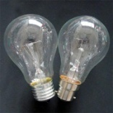
BLY Scheme Architecture
Buyer in Annex I
Country
PoA -Manager
Communication
CDM EB
Monitoring report
Allocation of CERs
Host Approval
DNA
DOE
Technically prepare PoA-DD
Registration of PoA
Coordinating & managing entity
Payment for CERs
CERs sold
CFL INVESTOR
Fused CFL’s returned
HOUSEHOLD
Safe disposal of returned CFL
Replaced ICL lamp
Buying CFL
Contract for implementation
DISCOM
CFL = Compact Florescent Lamp ICL = Incandescent lamp
DOE = Validators
BEE = Bureau of Energy Efficiency
DISCOM = Distribution Company
Safe keeping of replaced ICL lamp for inspection
CFLs to replace ICL
Prepare CPA-DD
Database about consumers
Selection of sample groups

Slide 6
BLY--Monitoring & Verification
Simplified M&V: AMS IIJ
Deemed savings approach: 3.5 hours / day/ CFL
In-use CFLs determined by survey
CPA Project area
Total area serviced by
DISCOM
MS-2
MS-1
MS = Monitoring Survey in year 1,2,3…
till end of crediting period
Notes:
Identify a viable methodology.
2007: BLY started off as AM0046 and later turned to AMS IIC under pilot.
2008: final choice of in-between AMS IIJ and AMSIIC made and finally settling on AMS IIC.
2008: final choice of in-between AMS IIJ and AMSIIC made and finally settling on AMS IIJ.
Key decision factor→ the needs of the investor
Learning's→ Baseline line survey sampling methodology with 90% confidence level and random households chosen with ‘random number generator’

Slide 7
Learning's and Risk Mitigation Experience

Slide 8
# 1-- Reduced Transaction Costs
 | CDM (normal) | CDM (Programme of Activities)
Time | 2 years; replication by starting anew | 2 years (one time); replication 2 months
Cost | Atleast INR 30 lakhs, $ 0.66 million | INR 50 lakhs (one time), $ 1.1 million; Replication INR 10 lakhs, $ 0.22 million
Assumption: I $ = INR 45

Slide 9
# 2– CME is like Eye of Storm
Develop a strong institutional CME which can
generate trust amongst stakeholders
Wield (explicit or implicit) authority on key stakeholders
Independent resource provision NOT linked to profits
Ready access to professional know-how
BLY Example:
BEE performs the role of eye of a storm and yet is independent of investor and Utility who provide last mile connect
Tip: A strong eye holds the storm
Notes:
9

Slide 10
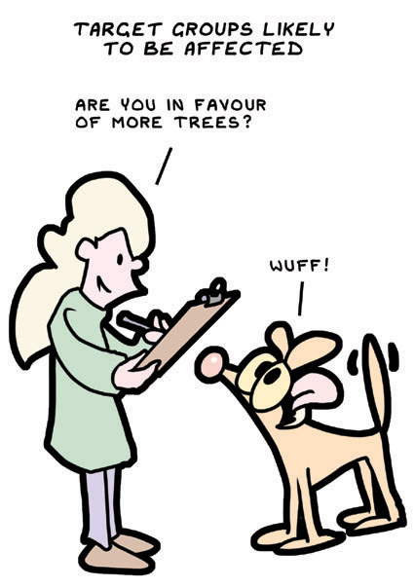
# 3-- Consulting Stakeholders Pays
Consult Stakeholder(s)
Provides 360° due diligence on project design
Identify barriers to uptake and develop enablers
Builds transparency of decision making
Ensures buy-in
Tip:
Web-site based consultation reduces costs and is quick and convenient
Budget adequate time to enable 2-3 consultations
BLY example
National stakeholder meeting facilitated by Greenpeace
periodic meetings held (till-date) with Investors / Utility to iron out gaps
Notes:
BLY Example:
initially wide use of low-power factor CFLs under BLY proposed.
Utilities apprehended this to be detrimental for grid stability.
BEE worked with Bureau of Indian Standards to shift standards towards high power factor CFLs, which were adopted in 2009.

Slide 11
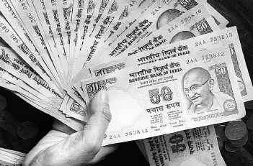
# 4— Simplify Monitoring & Verification
Reduce Investor Risk
Reduce data monitoring and assurance costs using e.g. Pre-defined factors, sampling plans
Develop standard templates and provide public access
BLY example
use of simple deemed saving methodology AMS IIJ instead of AMS IIC
BEE developed all documents & templates and maintain it on its website
Tip: Focus on predictibility of returns and ease to investor!

Slide 12
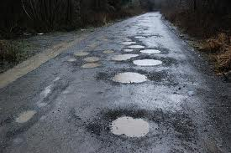
& requires us to work
The PoA road ahead is full of pot-holes….

Slide 13
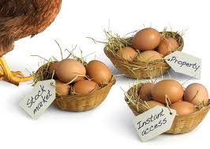
Pothole # 1– Restriction on Diversity
Required--Multi-investor friendly PoA norms on
CPA specific Project participant status
CPA verification on choice, and not as a bundle
Restrict 3-month gap in-between request for issuance to CPA and not PoA
Allow decentralization of CME functions within a PoA
Diversify investors, CMEs to reduce risk of failure
Notes:
BLY Example:
initially wide use of low-power factor CFLs under BLY proposed.
Utilities apprehended this to be detrimental for grid stability.
BEE worked with Bureau of Indian Standards to shift standards towards high power factor CFLs, which were adopted in 2009.

Slide 14
Pothole # 2– Unrestricted Liability
Required– definition of consequences of erroneous inclusion i.e. extent of sharing in the case
Multiple-CPA investors and
Multiple DOE
Liability distribution is good philanthropy…
…. not good business!
Notes:
BLY Example:
initially wide use of low-power factor CFLs under BLY proposed.
Utilities apprehended this to be detrimental for grid stability.
BEE worked with Bureau of Indian Standards to shift standards towards high power factor CFLs, which were adopted in 2009.

Slide 15
Pothole # 3– Simple Methodologies
Required– Current approved methodologies are complex entailing high monitoring costs;
thus not amenable to scale-up like in a PoA or NAMAs.
develop new simple methodologies with few ex-post monitoring requirements. e.g. AMS IIJ
Review methodology approval process for PoAs to reduce time and effort.
Are we magnifying complexity ?

Slide 16
The choice made by our generation, …will affect life on earth for all generations to come. …Working together each person can make a difference
Contact Information:
West Block-II, R. K. Puram-1
New Delhi- 110 066, India.
Tel: +91-11- 2619 4770
Fax: +91-11- 2619 4564
Email:
manu.maudgal@giz.de
vthakur@beenet.in

