Slide 1

Improved Cook Stoves for East Africa (ICSEA) Ltd
Bonn, May 7/8, 2011

Slide 2
Access to Carbon Finance for Improved Cook Stove Supplier Organisations Across East Africa
A 6-country PoA using AMS-II.G

Slide 3
Issues
To see how easy ‘open access’ to a PoA for a variety of ‘Supplier Organisations’ would be.
Definition of a feasible multi-country boundary = East African Community rationale.
Local concerns to ensure that CER revenues are fairly shared with those who create the emission reductions.
Constant enquiries to forward sell the PoA’s CERs – which it does not own.
How to communicate PoA complexities to a broad audience locally.

Slide 4
Mission
“To make affordable improved cook stoves
available to low-income households on a fair trade basis”
Key PoA features:
ICSEA is a carbon access service organisation
Funded by equity and grants
CPAs are free to market their CERs – no CME monopoly
Fair trade features are expected from CPAs in the way that carbon income is shared with stove users
CPAs are ICS ‘Supplier Organisations’ – they can be manufacturers, importers, distributors etc. – open access
Stoves Support Facility and Seed Fund run by the CME
All PoA registration documents were written in-house

Slide 5






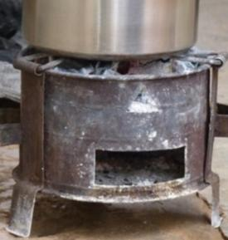
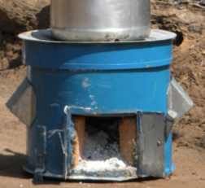
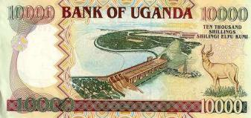
Interested Buyer of Reductions
CO₂
CO₂
industrial country
buys “carbon credits”
CARBON CREDITS

Slide 6
THE RESULT
Women can buy better stoves at a lower price, plus stove maintenance, & some carbon cash!
CO₂
CARBON CREDITS

Slide 7
Stoves PoA Philosophy
“Creating a self-sustained carbon-financed stove market at very low cost to participants”
CME
Structure
Equity & Donor $
Make/import & sell stoves
Private $

Slide 8
Stoves PoA future state
PoA
Customer choice
Affordable price
Largely scalable
Cleaner environment
Make/import & sell stoves
Carbon $
+
Private $

Slide 9
Issues
To fully recognise the substantial business risks of being the CME for the PoA.
To raise funding for the PoA’s registration and the early years of its operations.
To create a PoA Management Plan consistent with the PDD and CDM requirements.
To become fully conversant with the whole body of CDM PoA-relevant documentation.
To establish clear PoA descriptive materials for local stakeholders.

Slide 10
Stoves PoA Values
Fair Trade:
  Individual or grouped carbon credit sales
  PoA management is funded on a “service fee” basis
  Rise in CER prices goes largely to CPAs
  Provide up-front Seed Funds for CPAs when required
Maximum Social Impact:
  National environmental approval of each CPA
  Consumer health and safety requirements
  Major environmental benefits
  Free market approach:
    Lowers price
    Creates incentives for sustained use of improved stoves
    Increases choice

Slide 11
From concept to Carbon Credits
Qualified Design(s)
Authorized Supplier(s)
Carbon Credits
Verified Monitoring Results
Stoves sold
Carbon
Credits
Baseline Coefficient
Stove rating

Slide 12

Objectives of the Monitoring Plan
Validated Monitoring Plan
To ensure compliance with the requirements of UN (CDM), Gold Standard, etc.
To achieve the maximum possible carbon credits and value for each participant
To prevent fraud in any form

Slide 13
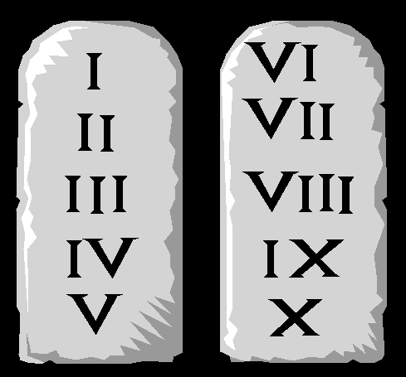
Duties of Stoves Suppliers
Validated Monitoring Plan
Thou shall…
sell the same type of stove that was lab rated
keep current, accurate and honest sales records
deliver sales records in computerised format
deliver original buyer agreements to the PoA CME
inform the CME of any errors or sources of leakage
cooperate with all PoA monitoring activities

Slide 14
Issues
To identify options for stoves testing criteria – submission of a clarification request to the EB.
Understanding the rules regarding the start of stoves crediting.
Technical options for stoves rating, sampling, monitoring, tracking etc.
CPA management planning to comply with small-scale meth limits.
Development of legal templates to embody best business practice and CDM compliance.

Slide 15
PoA Fair Trade Aspects
Group carbon credits sales if needed.
Appliance user is rewarded from CER income.
PoA CME is funded on a “service fee” basis.
Rise in sales price of carbon credits goes largely to CPAs.
CME provision of Seed Fund money for CPAs if required.
CARE carbon project principles adhered to.

Slide 16
Benefits Distribution
“Standard” Project
ICSEA CDM PoA
PoA management fees recovered from CERs
Buyer can resell VER ~$14
(Project’s ‘40%’ is now 25%)
CPAs or CME sell CERs in the market
Broker sells VER @ $9 to buyer
CPA manages the proceeds from creating a marketable carbon credit.
Each CPA decides on how to share these proceeds.
40% could be project’s share

Slide 17
Issues
Practical lessons now learned about DOE hiring.
Pioneering DNA and Host Country Approval processes for a first multi-country PoA.
Registration of the CME, business funding and shareholder selection.
Start of CME operations and database development.
CPA dealflow development in the light of market and regulatory uncertainties.
Development of extreme patience & optimism.

Slide 18
Many thanks to:
Supporters
GIZ
GIZ-CIM
Nordic Climate Facility
DFID
CARE Denmark
Validating DOE: Tuv Rheinland
First CPA: International Lifeline Fund, Lira, Uganda
www.ugandacarbon.org

