Slide 1
Generalities of NAMAs
(and specificities about the buildings and residential sector)
Claudio Forner
NAMA and registry

Slide 2
Outline
Introduction
NAMAs in the building sector
The new MRV framework

Slide 3
What are NAMAs
Negotiations under the UNFCCC
Kyoto Protocol second commitment Period
Bali Action Plan

Slide 4
Origins
That something….

Slide 5
Decision 1/CP.16
Developing country Parties will take NAMAs in the context of sustainable development, supported and enabled by technology, financing and capacity-building, aimed at achieving a deviation in emissions relative to ‘business as usual’ emissions in 2020

Slide 6
An Evolving UNFCCC
2 degree goal
Developed:
KP QELROS
Other convention’s commitments
Developed:
KP QELROS
Pre 2020 targets
Other convention’s commitments
$
New market arrangements
Developing:
CDM “CERs”
Other mitigation actions
Developing:
NAMAs (pre-2020, other)
LEDS
CDM “CERs”
Other mitigation actions

Slide 7
Overview of NAMAs
Two avenues for work on NAMAs:
“Political process” (ref: decision 1/CP.16, para. 50:
    Political actions
    Intensity targets, BAU objectives, programmes
    Compiled in FCCC/SBI/2013/INF.12
Registry (individual NAMAs)
    Implementation actions
    Individual NAMAs looking for support
    Other NAMAs

Slide 8
Overview of FCCC/SBI/2013/INF.12/Rev.1
57 Parties and the African Group have submitted NAMAs, corresponding to approximately 37.5% of developing countries:
      Africa: 25
      Asia: 13 (not including SIDS)
      Latin America: 7 (not including SIDS)
      Eastern Europe: 3
      SIDS: 7
      Other: 2

Slide 9
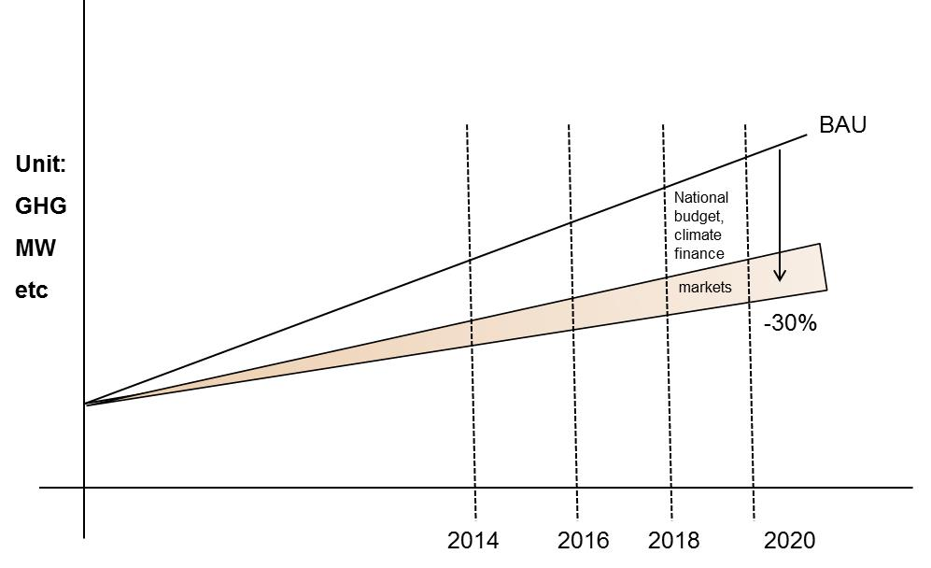
Mitigation actions: e.g. deviation from BAU
Policy in sector Y
Programme
in sector X
Markets
(e.g. issuances sold)
intervention 1 Intervention 2
Project 1
…

Slide 10
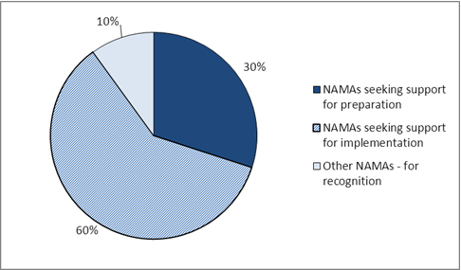
Overview of registry content in 2013: Characterization of NAMA entries by type
The majority of NAMA entries are seeking support and the majority of these are seeking support for implementation
Notes:
The majority of NAMAs entries in the registry are those seeking support for implementation.

Slide 11
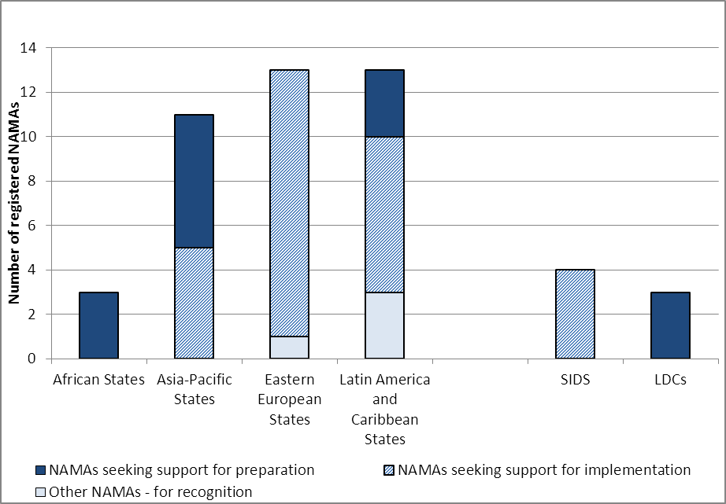
Overview of registry content in 2013: Characterization of NAMA entries by type
Types of support needed is different by region
Notes:
Different regions have different profiles in terms of the support they are seeking, African states are seeking support more for preparation whereas eastern european states are seeking support more for implementation

Slide 12
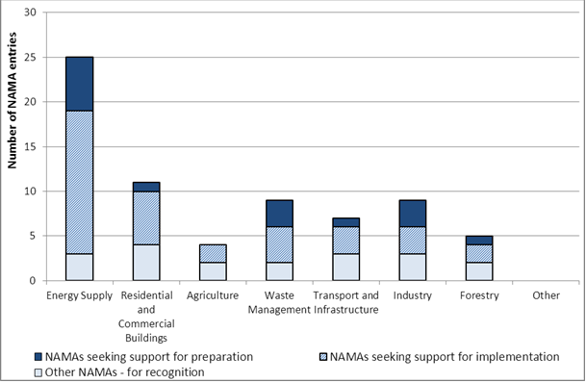
Overview of registry content in 2013: Characterization of NAMAs by sector
The energy supply sector is the sector relevant to most NAMA entries
Notes:
So looking in more detail at the types of NAMAs entered in the registry so far, the sectoral breakdown of entries shows that the energy sector is most relevant to most NAMA entries, over half of the NAMAs entered so far include the energy sector

Slide 13
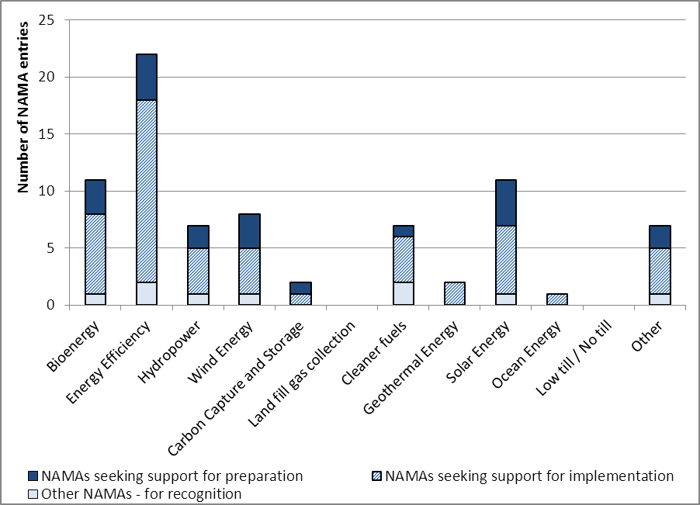
Overview of registry content in 2013: Characterization of NAMAs by technology
Energy efficiency is the technology relevant to most NAMA entries
Notes:
From a technological perspective, energy efficiency is the technology cited by the most NAMAs

Slide 14
NAMAs in the buildings and residential sector
A total of seven NAMAs specific to the residential/buildings sector
Mostly broader programmes
Mostly apply to heating and lighting
Mixture or renewable energy and energy efficiency measures
Mostly in “idea” status

Slide 15
Specific measures
  Programmes for solar water heaters s
  Improvements/expansion of heating systems for districts
  Energy metering
  Refurbishing of old public buildings (replacement of doors, windows and insulation)
  Overall strategies for efficient lighting:
    Codes and standards
    Financial incentive schemes
    Public awareness campaings

Slide 16
Best practice: Mexican Housing NAMA
Aimed at establishing a programme for sustainable housing to meet current demand
Designed by CONAVI and SEMARNAT with support from GIZ
To be funded by, among others the NAMA facility
Aims:
  Extend penetration of efficiency standards to new housing
  Upgrade existing efficiency standards
Green mortgage schemes that provide incentives for:
  Energy efficient appliances (refrigerators and AC)
  Photovoltaic instalation

Slide 17
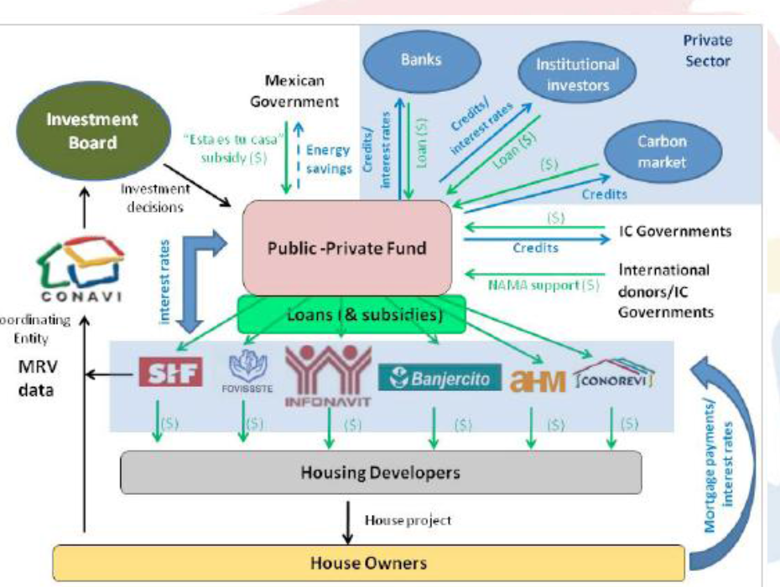
Scheme

Slide 18
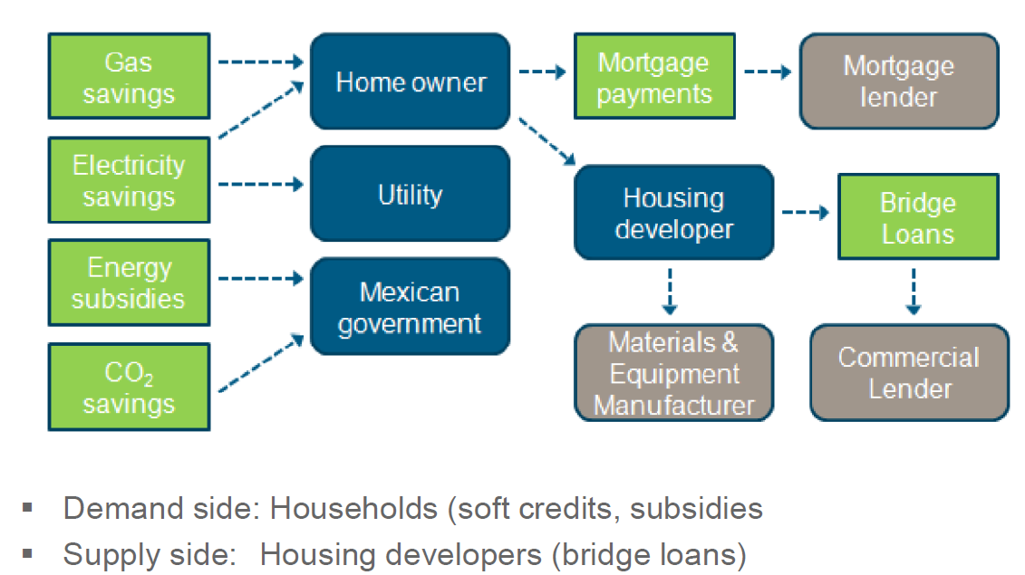
Benefit chain

Slide 19
Characteristics of bankable NAMAs
Robust MRV
  Embedded in national systems (and linked to national objectives)
  Established indicators (mitigation and SD)
  Transparent and robust methods and methodologies
“Bankability” :
  National ownership
  Climate benefits
  Sustainable development benefits
  Transformational impact
  Financial sustainability

Slide 20
MRV
International MRV
M
National communications
Biennial update reports
International consultation and analysis
Domestic MRV
General guidelines to describe the domestic MRV of domestically supported NAMAs
Voluntary use
REDD+ MRV
R
Modalities for MRV of REDD+ activities
Voluntary - obtain and receive payments for results-based actions
V

Slide 21
Mitigation actions within the BUR (decision 2/CP.17, annex III)
Name and description of mitigation action, including information on the nature of the action, coverage, quantitative goals and process indicators
Methodologies and assumptions
Objectives of the action and steps taken or envisaged to achieve that action
Progress of implementation of the actions and results achieved (estimated outcomes and emissions reductions)
International market mechanisms
Domestic MRV

Slide 22
International consultation and analysis workflow
Submission of BURs
International consultation and analysis
Technical analysis
Facilitative exchange of views
Composition of TTE
A workshop under SBI - a one- to three-hour session for each Party or group of Parties
Technical analysis of BURs by TTE
Final SR noted by SBI and posted on UNFCCC.int
A brief presentation by the Party or Parties concerned on their biennial update report, followed by oral questions and answers among Parties
Draft summary report (SR)
Record of the facilitative sharing of views
Review and comment on draft SR by the Party concerned
Final SR by TTE & the Party concerned
OUTPUTS OF INTERNATIONAL CONSULTATION AND ANALYSIS

Slide 23
Thank you

