Slide 1
The Common Carbon Metric (CCM) protocol and tool
Urban methodologies for the built environment workshop
27th-28th March 2014, Bonn, Germany
A Common Language for measuring CO₂ performance of buildings
Professor Rajat Gupta
Oxford Brookes University, UK
rgupta@brookes.ac.uk
Notes:
This presentation has to be delivered in 20 minutes
Ladies and Gentlemen
It is a great pleasure for me to be here today and to have the opportunity to present the first ever common carbon metrics, providing a basic building block for any international policies to reduce greenhouse gas emissions from buildings.
The Common Carbon Metric protocol and reporting template provides industry with a globally consistent methodology by which to measure energy use and report related greenhouse gas emissions from building operations.
This Common Carbon Metrics has been jointly developed by a large number of national and international organizations and experts concerned with energy efficiency and climate mitigation in the building sector.
In this presentation I will give you a brief introduction to the Metrics, and I will outline how it may enable the building sector to contribute significantly through emission reductions to a low-carbon society.

Slide 2
  Structure of presentation
  Brief background on the development of Common Carbon Metric
  CCM methodology
  CCM Pilot Phase 1
    Key findings
  CCM Pilot Phase 2
    Techncial enhancements
    Key findings
  Next steps and wider application of CCM

Slide 3

  Policy Approaches
  Appliance standards Taxation
  Energy performance contracting
  Mandatory auditing Tax exemtions
  Public benefit charges CDM Cap and Trade
  Building codes
  Negotiated agreements Utility DSM
  Cooperative procurement Detailed billing
  Labelling White certificates
  Information Public leadership programs
  Subsidies& grants
Notes:
Now to UNEP-SBCI’s rationale for the CCM:
There are a large number of proven policy approaches to reduce the climate footprint from buildings
These include buildings codes, demand side management programs, public benefit charges, tax exemptions, subsidies, taxation, negotiated agreements, building rating schemes, cooperative procurement and many more.
Such policies may be implemented at national or local levels, or be part of a larger regional or international programs and agreements to support emission reductions in buildings.
However, to implement ambitious policies, we have to be able to demonstrate the real performance of buildings and account for efficiency gains and emission reductions, with appropriate measures and verification processes, and clearly that point is a real challenge.

Slide 4
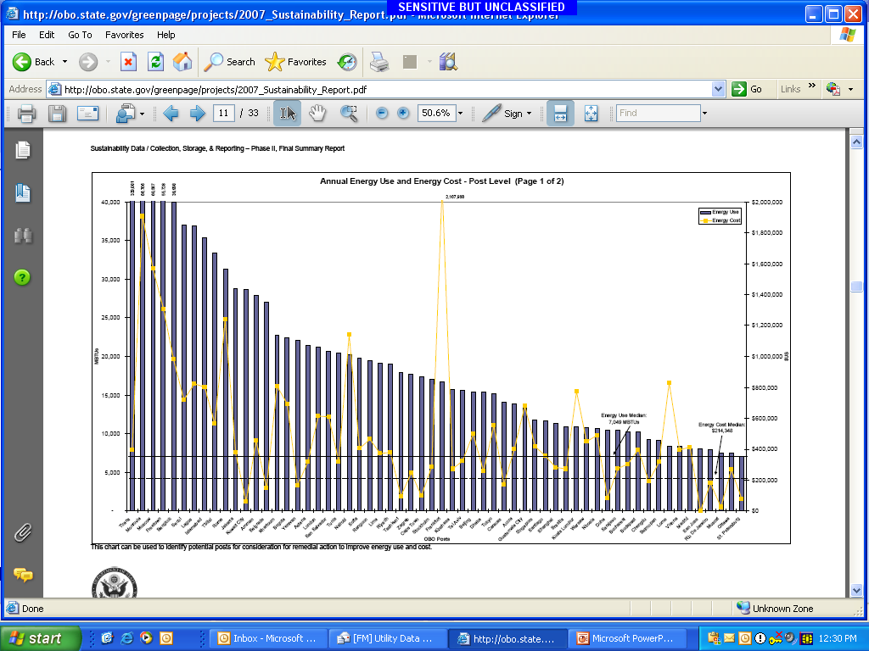
Need for Common Carbon Metrics
Standardization of building Indicators, Metrics, & Protocol: Establishing Energy Performance and GHG emissions Baselines
Use per m²
Use per occupant
Baseline Performance
Target Performance
Energy use in kWh
By Region
Notes:
The end goal is to be able to establish REGIONAL baselines for energy performance and emissions so that we can agree on the norms and best practices to inform policy and targets.

Slide 5
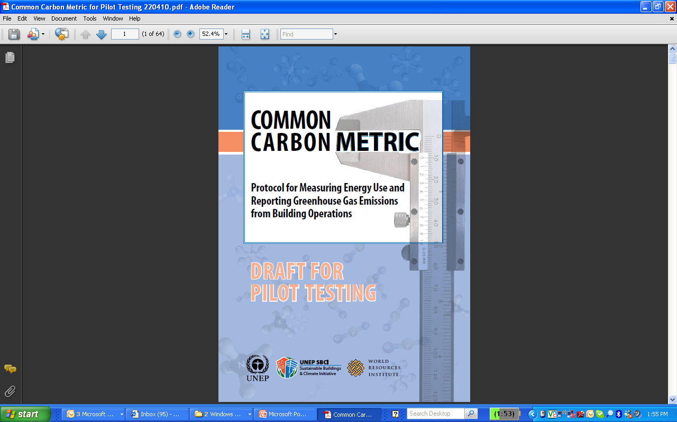
The Common Carbon Metric (CCM)
Measuring Energy Use & Reporting GHG Emissions from Building Operations
CCM protocol and Excel based tool
Developed by UNEP: SBCI
Energy
kWh/m²/yr
kWh/occupant/yr
Emissions (equivalent (e))
kgCO₂e/m²/yr
kgCO₂e/occupant/yr
Notes:
The metric itself is quite simple and practical.
The metric offers two indicators: Energy intensity expressed as kWh per m2, and Carbon intensity expressed as CO2 eqv per m2 and per occupant. This latter measure would be applicable in residential buildings only.
The metric accounts for energy consumed during building operations.
Energy may be consumed as on-site consumption of fuel, as purchased electricity, and as purchased heat/cool/steam.

Slide 6

  The Metric
  A methodology used to define buildings climate impact
  Consistent with principles and standards for environmental performance assessments (ISO standards and WRI/WBCSD Greenhouse Gas protocol)
  Meets the requirements that reporting is measurable, reportable and verifiable (MRV)
  Allows for bottom-up, and top-down data compilation
  Phase 1 pilot: 2010-2011
  Phase 2 pilot: 2011-2012
Notes:
The Common Carbon Metric offers a consensus, reached by a large number of international and national expert organizations from all parts of the world, on the indicators that define the operational energy-related climate impact of buildings.
The Metric is consistent with established standards and principles for environmental performance assessments, including the Greenhouse Gas protocol of the World Resources Institute and the World Business Council for Sustainable Development; the ISO standards 15393:2008 on sustainability in building construction, as well as with the ISO 14040/44:2006 on Life Cycle Assessments.
The metric has been also developed to provide Measurable, Reportable and Verifiable information on the climate performance of buildings in accordance with the Bali action plan. These MRV requirements will allow being part of Nationally Appropriate Mitigation Action (NAMA) – one of the new mechanisms discussed to support emission reduction in developing countries.
It is the first stage in provding a consistent aproach for measuring and reporting base-line GHG emissions from building stock.

Slide 7
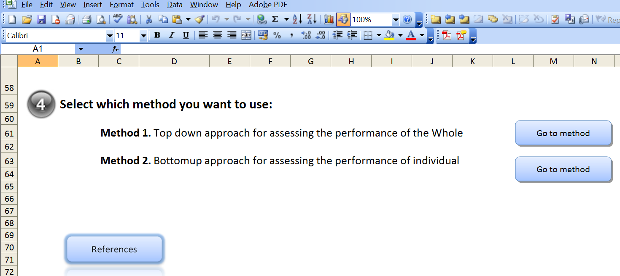

  CCM methodology
  Top-down approach: Performance of the whole (regional, city or national level) is characterized at a coarse level using estimated data on fuel and electricity consumption.
  Bottom-up approach: Performance of individual case-study buildings is characterized at a fine level using measured data on fuel and electricity consumption.
    Ideally sample size will be statistically valid, enabling verification of the whole.

Slide 8
  Top-down approach: data requirements
  Area of the Whole (m²).
  Total occupancy of the whole (number of occupants, or number of residents where information on occupancy is limited).
  Information on the percentage of the Whole’s occupants and building area attributable to different categories of building stocks (%). At a minimum, data must be allocated amongst two broad categories of buildings: residential and non-residential buildings.
  Information on the total amount of electricity consumed by the Whole and on the amounts of different types of fuels used
  Information on the percentage of the Whole’s electricity and fuel use that is attributable to different categories of building stocks (%).
  Custom emission factors may optionally be provided in place of the default emission factors for electricity and fuel use.

Slide 9
  Bottom-up approach: data requirements
  Descriptive information, including building name, building category, year of construction and year of last major retrofit, and address.
  Occupancy (number of occupants) and area (m²).
  Data on the total amount of purchased and metered electricity (in kWh).
  Data on the total amount of different fuels consumed (various measurement units).
  Custom emission factors may optionally be provided in place of the default emission factors for electricity and fuel use.
  Users may optionally report the amount of purchased green power or the amount of renewable energy that has been generated on-site and returned to the grid.

Slide 10
  CCM Phase I Pilot
Performance metrics computed for a total of:
  49 individual buildings (total area: 1.48 km²)
  5 larger stocks (or Wholes) (total area: 176.60 km²)
  Submissions spanned multiple climate regions in Australia, Asia, Europe, India, N. America, and Africa.
Notes:
These submissions allowed performance metrics to be computed for a total of 49 individual buildings (total area: 1.46 km2) and for five larger stocks (or Wholes) (total area: 176.60 km2).
These submissions spanned multiple climate regions in Australia, Asia, Europe, India, N. America, and Africa.

Slide 11
  CCM Phase I Pilot
Performance of a building stock at the city level
Red cells indicate that average performance of a set of buildings of a given building type, as measured through the bottom-up approach, is worse than the performance of the whole’s non-residential building stock.
Notes:
Note: Red cells indicate that the average performance of a set of buildings of a given building type, as measured through the bottom-up approach, is worse than the performance of the Whole’s non-residential building stock. Green cells indicate better performance compared to the Whole’s non-residential building stock.
Using the top-down approach, City A provided data on a geographically defined Whole (total area: 176 km2) with an occupancy of 3,700,000 and a total energy use of 63,152 TJ. City A was able to generate performance baselines for its residential and non-residential building stocks at the level of the Whole. City A also provided data on 10 non-residential buildings through the bottom-up approach, allowing it to compare the average performance of these buildings with that of the Whole’s non-residential stock

Slide 12
  CCM Phase I Pilot
Performance baselines of a single building type
Notes:
Company A provided information on 11 office buildings, which together had a total occupancy of 3,797 and a total floor area of 84,717m2. Based on the electricity and fuel use of these buildings, the CCM computed performance baselines for Company A’s portfolio (Table 3).
In this submission it is possible to identify buildings that belong to the same building type, but vary in their performance due to their reliance on different fuel sources.
For instance, ‘Building 1’ has markedly better performance than does ‘Building 5’, because Building 1 relies entirely on electricity for its energy needs, while Building 5 relies on a combination of electricity and fuel.
The inclusion of Building 5 in the sample set decreases the sample’s average performance.

Slide 13
  CCM Phase I Pilot
Key outcomes
  Developing consensus-based definitions
Notes:
Phase 1 of the CCM used the following definition for building floor area: “Building area is measured in meters squared (m2) of Gross Floor Area (GFA) of a building. GFA is measured from the exterior perimeter of the building envelope.
Areas of internal walls & structure, shafts, elevators, and stairways are to be included in the GFA.”
Based on feedback, UNEP-SBCI has refined this definition for subsequent phases of the CCM, as described in the slide.

Slide 14
  CCM Phase I Pilot
Key outcomes
  Categories of building types
Notes:
Phase 1 of the CCM employed a limited list of building types for residential and non-residential building stocks, because of the CCM’s emphasis on the top-down approach, for which only limited data may be available. Specifically, these building types were: single-family residential, multi-family residential, hotel, office and retail.
This list was deemed insufficient by many reviewers for decision making purposes. However, the building types employed in certain regions may not correspond (in name) to those used elsewhere, and the International Standards Association (ISO) has not developed guidance on this issue. This required UNEP-SBCI to undertake research on terms adopted in widely used building-related tools and protocols. Because the CCM is intended to draw from existing and widely-used standards, UNEP-SBCI has adopted the list of building types developed by the United Nations Framework Convention on Climate Change’s (UNFCCC’s) Clean Development Mechanism (CDM), at least for Phase II of the CCM. These building types and associated definitions are listed in Table 5. The UNEP-SBCI Energy/GHG Technical Advisory Committee (TAC) shall work to provide a matrix of country standards that define building types and map those types to the UNFCCC definitions. The TAC shall also work to supplement the UNFCCC definitions, as needed, by including more building sub-types to allow for more accurate comparisons between building types.

Slide 15
  CCM Phase I Pilot
Key outcomes
  Occupancy
Notes:
The ratio of people-to-building-area differs greatly depending on building type, function, and country. Some countries have developed standard occupancy defaults for specific building types. In addition, there are a variety of ways to calculate and estimate building occupancy, such as annual hours of building operation. Consequently, consistent measurements of occupancy are crucial. The CCM does not provide a single definition for occupancy estimations at this stage, nor does it provide any country or building-type defaults. However, the review process identified several general rules-of-thumb that can be used:
Occupancy of residential buildings can be determined using the number of persons sleeping within the defined area.
Occupancy of non-residential buildings for the bottom-up approach may be determined using the “full-time equivalent” (FTE) concept, which requires users to estimate how many people occupy a given building for approximately eight hours. Visitors and part-time staff can be totaled up and divided by eight hours and added to the total as FTEs. Any occupancy data must reflect the number of actual occupants, as opposed to the number of intended occupants.
Ideally, the CCM should take into account real life situations where data may be lacking and provide proxy methodologies for computing performance. Data on occupancy at the level of the Whole are especially likely to be limiting and the review process identified a proxy methodology for when such data are not available: users may enter data on the number of residents, as opposed to the number of occupants. This proxy is mainly suitable for residential building stocks, because the long-distance commuting of workers will affect the number of occupants of non-residential buildings. Note also that the daily influx of workers to a city may not accurately reflect how many of those workers work within the building area, as they may have strictly outdoor or industrial occupations.

Slide 16
  CCM Phase II Pilot
Technical enhancements in CCM tool
  Expanded list of residential and non-residential building types based on UNFCCC’s building categorizations.
  Normalize building performance by degree day information
  Use custom emission factors in addition to the default IPCC and IEA emission factors as defaults.
  Input fuel consumption data by month through the top-down and bottom-up approaches.
  Input information on multiple fuels for the same building.
  Record the year of last building retrofit.
  Record amount of purchased green power or amount of renewable energy generated on-site and returned to the grid.

Slide 17
  CCM Phase II Pilot: Enhanced CCM tool
Normalizing energy performance using weather data
Notes:
A building’s energy use related to heating and cooling is a function not only of the efficiency of the building envelope, building orientation to the sun and shading, and heating/cooling equipment, but also of the climatic conditions of where the building is located. A key goal of the CCM is to allow the normalization of building energy performance (not GHG performance) by climate (heating and cooling degree days). This is to allow the meaningful comparison of the performance of different buildings located in different places, or of the same building year after year.
In obtaining degree day data for input into Phase II, users will have to do the following at this site:
Identify the closest weather station to the building stock.
Select whether heating or cooling degree day information is required, along with the preferred temperature unit.
Select an appropriate base temperature, which represents the outside temperature above which a building needs no heating (for heating degree days (HDD)) or cooling (for cooling degree days (CDD)).
Request an average breakdown for the appropriate twelve month reporting period.

Slide 18
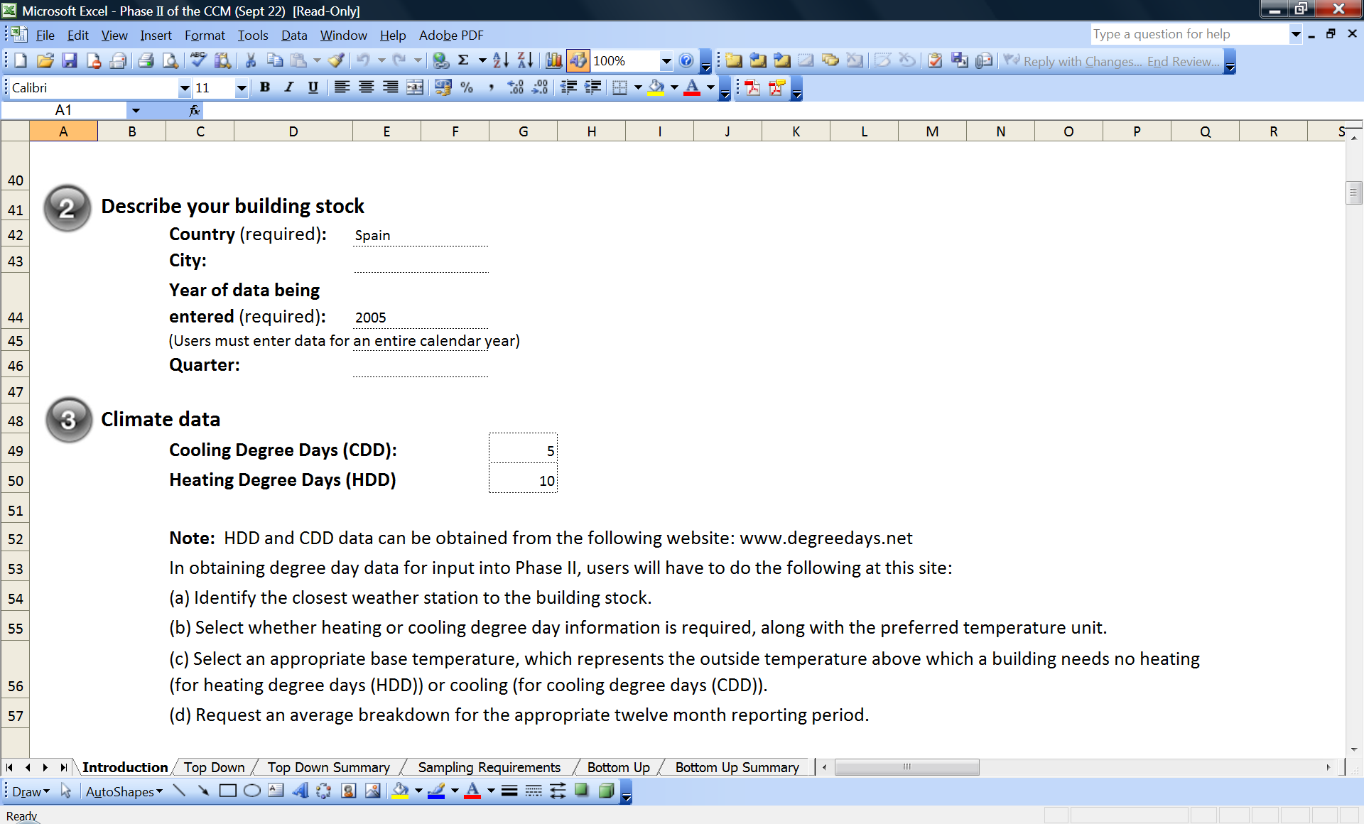
  CCM Phase II Pilot: Enhanced CCM tool
Normalizing energy performance using weather data

Slide 19
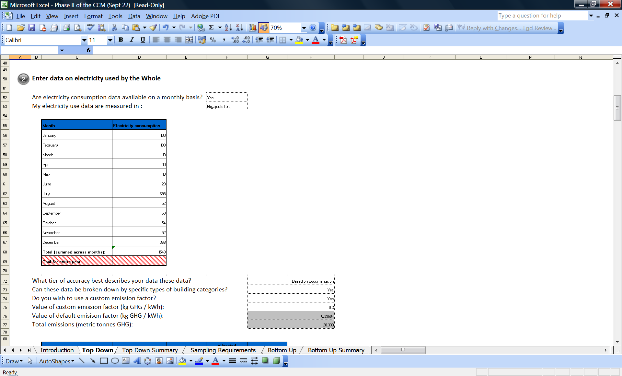
  CCM Phase II Pilot: Enhanced CCM tool
Monthly data on fuel consumption

Slide 20
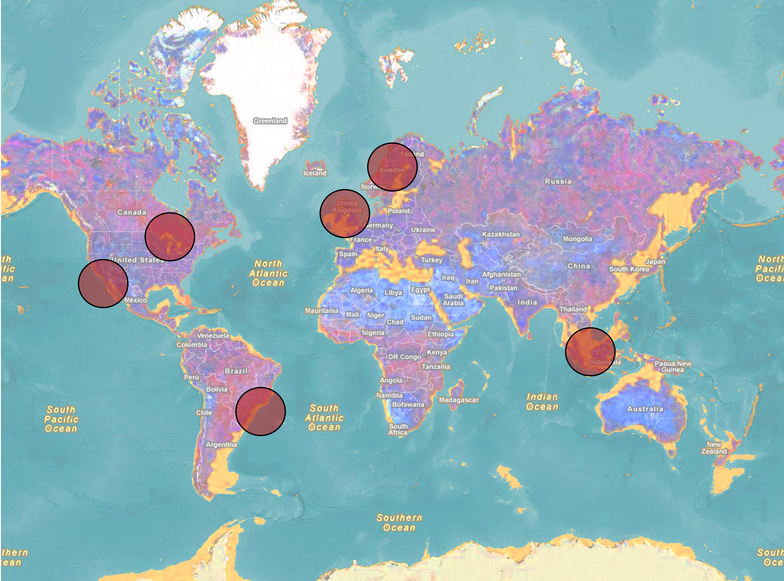
  CCM Phase II Pilot:
  Participants from North America, South America, Asia, Europe
  Performance metrics being computed for a total of:
  >150 individual buildings
  (total area: 7.4 km²)
  7 larger stocks (or Wholes) (total area: 177 km²)

Slide 21
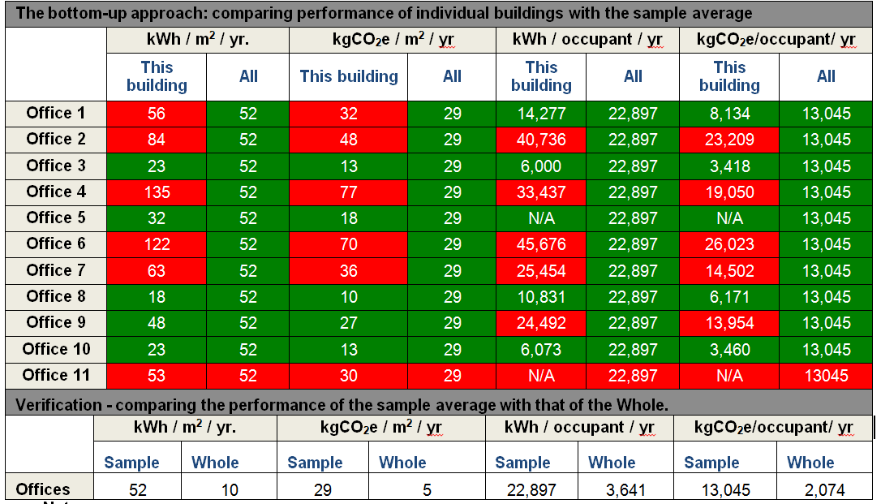
  CCM Phase II Pilot:
  Organisation A: Top-down and Bottom-up approaches
Notes:
All refers to ‘Sample average’
N/A implies that data for occupancy for that case study office building were not input by the pilot participant
Red cells indicate worse performance compared to the sample average. Green cells indicate better performance compared to the sample average.

Slide 22
  CCM Phase II Pilot: Participant feedback
Most participants felt that the range of fuels provided was adequate.
Increased information on how to interpret results, with comments on performance benchmarks would be highly valuable to the inexperienced user.
Country specific guidelines for approximating data such as age of building and renovation
More graphical output and navigation buttons would be beneficial.

Slide 23
  Learning from the two pilot studies
Two pilot studies of CCM has revealed some interesting findings:
Need for a web based platform for the CCM tool to avoid incompatibility problems common in the Excel platform.
  Majority of submissions focused on measured data.
    Major step forward in the right direction given the widening gap between estimated and measured energy performance of buildings.
  Uptake of both approaches shows that CCM should remain committed to developing and testing both top-down and bottom-up approaches in the future.

Slide 24
  Wider application of CCM
ISO standard
CCM is currently being developed into an ISO standard on carbon metric of buildings (ISO/TC59/SC17).
Help to establish a system of MRV indicators for the follow-up of policy implementation and reporting on building-related GHG emissions.
National Appropriate Mitigation Actions (NAMAs)
Bali Action Plan, calls for measurable, reportable and verifiable NAMAs on a country level.
To facilitate NAMAs, a globally consistent MRV methodology is essential to measure and track energy use and energy reductions from buildings.
CCM is able to support the establishment of baselines from the sector or sub-sector (residential, commercial, etc.), thus allowing measurement over time of increased efficiency and GHG reductions from a particular building stock.
Notes:
National Appropriate Mitigation Actions (NAMAs)
Bali Action Plan, calls for measurable, reportable and verifiable NAMAs on a country level.
NAMAs for the building sector can assist developing countries in recognizing the significant mitigation potential of the building sector that can be integrated in broader national and regional strategies.
To facilitate NAMAs, a globally consistent MRV methodology is essential to measure and track energy use and energy reductions from buildings.
CCM is able to support the establishment of baselines from the sector or sub-sector (residential, commercial, etc.), thus allowing measurement over time of increased efficiency and GHG reductions from a particular building stock.

Slide 25
  Thank you!

