Slide 1
Experiences in carbon accounting for thermal performance improvements in low-income dwelling structures
Steve Thorne
founder and director SouthSouthNorth Africa
2014 Buildings and Urban Methodologies Workshop (UNEP-UNFCCC)
27th March 2014

Slide 2
Contents
History of experiences in Thermal Performance in South Africa.
Experience of meths.
Meth interpretation and development of new meths.
Thermal Performance approaches.
Suppressed Demand approaches and safeguards.
Main elements of calibration.
Issues remaining.

Slide 3
South Africa’s housing and energy challenge…

Slide 4
Policy History in South Africa
Early experimentation in CLEEPH housing by DMEA 1980s.
Thermal Performance of housing included in 1998 Energy Policy White Paper.
Included in the 2003 Energy Efficiency Strategy.
Again in 2009 Energy Efficiency Strategy.
Thermal Performance Standards for dwellings promulgated 2011.
SSF included in Climate Change Response Strategy White Paper in Oct 2011.

Slide 5
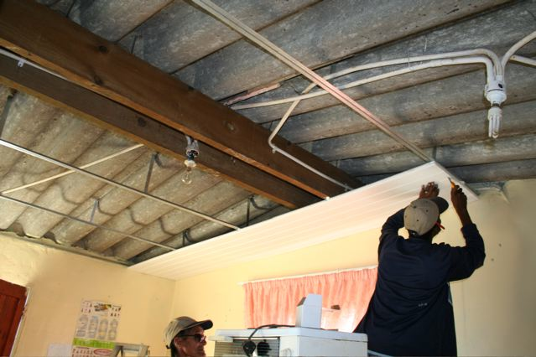
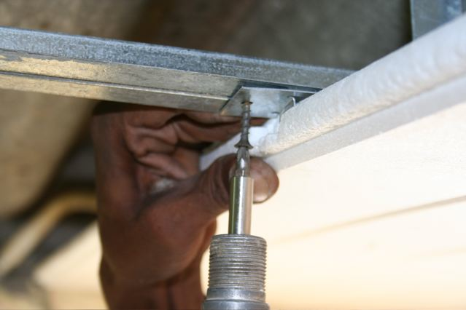
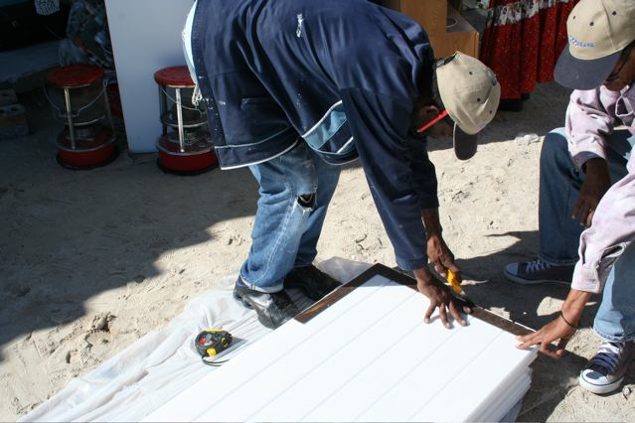
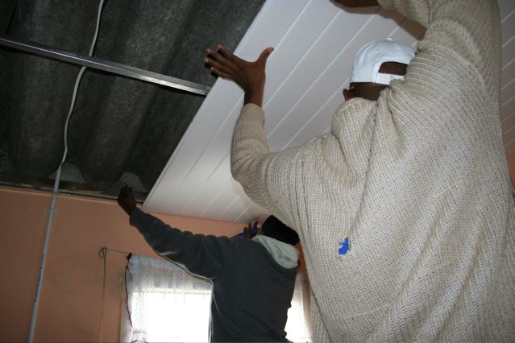
Insulated Ceiling installation - Public Works

Slide 6
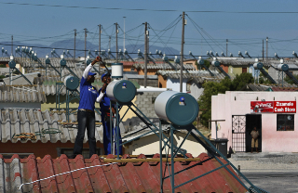

Slide 7
Thermal Performance Approaches
Regular public low-income dwelling structures
Initial retrofitting options in e.g. insulated ceilings
Predictive tools calibrated accounting for minimum service levels (thermal comfort Temp and humidity ranges in bioclimatic charts)
Inclusion of suppressed demand
Costly data gathering and model building
Attempted approval of CDM large-scale meths
Project registration (Kuyasa)
Considerations of AMSIII-AE
GSF large scale meth close to approval

Slide 8
Tools for current meth
The DesignBuilder and EnergyPlus combination is promoted internationally by the US Dept of Energy and has been validated by ASHRAE.
In this instance version 3 of EnergyPlus has been utilized, its ASHRAE verification is available. EnergyPlus has been validated under the comparative Standard Method of Test for the Evaluation of Building Energy Analysis Computer Programs BESTEST/ASHARE STD 140.
BESTEST (Building Energy Simulation TEST) is a comparative set of tests which has become one of the industry’s most accepted methods to validate and test the simulation capabilities of the exterior envelope portions of building energy simulation programs.
There are many other tools of various qualities.

Slide 9
Suppressed Demand Focus
Initially in COP7, then Kuyasa validation, much lobbying, Guidance in GS Decentralised Thermal Services Meth, UNFCCC Standard, then BMU-ICI project
Where maximum sustainable development can be achieved
Where fossil lock-ins can be avoided
Where poverty, lack of infrastructure or lack of natural resources exist
LDCs, LLDCs, SIDS, Sub-Saharan Africa
Learning-by-doing – learning to apply the clear principles and recalibrating approach
Where transaction costs can be minimised
Remain conservative wrt service levels (application requires livelihoods increasing as a precondition)

Slide 10
Gradual release of suppressed demand: Carbon Calculations that take interventions into account (e.g.: Thermal Performance improvements etc.)
___ Energy Service
___ Baseline Carbon emissions
___ Energy Service intervention
___ Carbon emission after clean energy service intervention
A are “Normal” Emissions Reductions
Energy service
Carbon emissions
B are “Normal” Emissions Reductions + Future Avoided Emissions
B
A
time

Slide 11
Empirical thermal comfort (as measured in the project)
Project structure or determination of the most plausible baseline structure
Determination of the baseline heating appliance
Determination of the most common active heating fuels in the baseline.
Determined periods of the year when space heating is needed
Capped thermal comfort
Non-sleeping occupancy (measured by sampling)
Structure
Climatic data
Baseline heating appliance
Baseline type of heating energy
Project service
Predictive tool
Active space heating for the considered project service
Emissions
Selection of an accurate predictive tool

Slide 12
Service levels – Thermal comfort
An easy way of describing the effect of air temperature, humidity, MRT, wind and sunshine is the Bioclimate Chart below.

Slide 13
Thermal Comfort

Slide 14
Non-sleeping Occupancy

Slide 15
Air-changes
This variable is squeezed to achieve “best-fit” in the empirical data collected during calibration.

Slide 17
Issues…
Thermal comfort and adaptive thermal comfort… minimum service levels.
Quality predictive tools (for heating and cooling).
Monitoring for calibration and emissions calcs.. May require public funds for regional calibrations.
How to deal with Suppressed demand?
Roles of expert institutions: American Society of Heating, Refrigerating and Air-Conditioning Engineers, Inc. ASHRAE®, Council for Scientific and Industrial Research (CSIR) etc.
Roles of Validators and Verifiers (DOEs).
Combinations with other low-income services.
Top-down or bottom-up approaches?

Slide 18
Experiences with Regulators
10 years of persistence.
Multiple submissions prior to Suppressed Demand Standard and Predictive Tools/Modeling were allowed in carbon accounting.
Both now embraced – teething with tools.
Questions now of how to prepare a menu of thermal (cooking, space and water heating), lighting, refrigeration, etc. and perhaps livelihood activities considering value chains.

Slide 19
Thanks
steve@southsouthnorth.org

