Slide 1
V-NAMA
Integrating sub-national actors into national mitigation strategies through vertically integrated NAMAs
Tobias Zeller, GIZ Division Environment and Climate
UNEP-UNFCCC Workshop on Urban Methodologies for the Built environment,
27 March 2014, Bonn

Slide 2
Guiding Questions
What are V-NAMAs and why do we need them?
What are objectives of the GIZ V-NAMA project?
What are lessons learnt from the V-NAMA on Energy Efficiency in Public Buildings?

Slide 3
Guiding Questions
What are V-NAMAs and why do we need them?
What are objectives of the GIZ V-NAMA project?
What are lessons learnt from the V-NAMA on Energy Efficiency in Public Buildings?

Slide 4
National (Voluntary) Targets will be met by Nationally Appropriate Mitigation Actions (NAMAs)
National (voluntary) Mitigation Target
South Africa:
-34% from BAU scenario
National Climate Change Response Strategy
South Africa:
White Paper (Adaptation and Mitigation)
Renewable Energy
Subnational involvement / vertical integration
GAP
Carbon Capture / Sequestration
Energy Efficiency / Demand Side Mgmt
Transport
Waste
27/03/2014
Notes:
Promised to say more about NAMA acronym:
Stands for Nationally Appropriate Mitigation Action
Become framework
Some key elements already becoming clear:
Voluntary – as opposed to Kyoto commitments – mandatory
Country Ownership – Nat Sust Dev priorities
Wide range of activities – perhaps incl. investments, capacity bldg, policy measures.
Scale – looking for transformative changes beyond project b p (CDM)

Slide 5
Why subnationals to fill the gap?
More than 50% of world‘s population in cities
Key competencies…
Waste management
Buildings
Transport
Cities consume 2/3 of world‘s energy supply
Cities are responsible for over 70% of CO2 emissions
high mitigation potential on subnational level
Notes:
Why at all involving sub-nationals in national mitigation strategies?
Depending on the country specific circumstances and the level of decentralisation, sub-national hold key competencies in GHG relevant sectors.
Ex. Indonesia: The waste sector counts for more than 9 % - and the amount is rising through the population growth in cities.
High mitigation potential.
National partner says that the V-NAMA project provides an entry point to address the climate change issues related to the solid waste management process and also as a model to implement the mitigation action in waste sector as part of the provincial climate action plan called RAD GRK.
Taking this into account, vertically integrated NAMAs refer to the need of strong collaboration of different governance levels (National, provincial/regional and local).
Ex. Peru: regional strategies on cc mandatory according to national regulation. However, no technical and financial support for design, implementation and monitoring.

Slide 6
Why is vertical integration necessary? Examples for different barriers for tapping the potentials
South Africa
Existing national grant programme for municipal public buildings is not used appropriately due to complicated application process and lack of capacity on local level
Central regulation makes ESCO-shared benefit con-tracts exceeding 3 years extremely difficult for locals
Indonesia
National Public Works is responsible for infrastructure investments (landfills, 3R-facilities, …)
Local level: operation/maintenance of infrastructure
Vietnam
National subsidies on chemical fertilizers lead to a lack of competitive market prices for local compost

Slide 7
Why vertical integration from a governance perspective?
National Government
Defense | Foreign Affairs | … | … | Environment / Climate | Energy | Public Works
certain responsibilities are shared between various levels
Provincial Government
… | … | Environment / Climate | Energy | Public Works | … | …
certain responsibilities only on one level of government
Municipal Government
Environment / Climate | Energy | Public Works | … | … | …

Slide 8
V-NAMA – vertical and horizontal cooperation
National MRV-system
Regulation and Incentives
Regulation and Incentives
National Government
Defense | Foreign Affairs | … | … | Environment / Climate | Energy | Public Works
Building stock
Building stock
Building stock
Mitigation target
Mitigation targets
Mitigation target
Provincial Government
… | … | Environment / Climate | Energy | Public Works | … | …
Municipal Government
Environment / Climate | Energy | Public Works | … | … | …
Notes:
All levels of government integrated, limited number of stakeholders, direct access to national climate decision makers, positive co-benefits for vertical integration of policies, real exchange and cooperation between the levels, limited cover of municipal GHG emissions, GHG emissions reduction can contribute directly to sectoral mitigation target

Slide 9
Guiding Questions
What are V-NAMAs and why do we need them?
What are objectives of the GIZ V-NAMA project?
What are lessons learnt from the V-NAMA on Energy Efficiency in Public Buildings?

Slide 10
Objective: To overcome the barriers for sub-national involvement/vertical integration in NAMAs
Lack of incentives
Lack of financial incentives
Lack of political/co-benefit incentives
Lack of integration
institutional weaknesses
institutional differences
Lack of capacity
insufficient skills and knowledge
insufficient data and information
Inadequate budget support
Poor access to finance (esp. international)
Potential loss of revenue
unclear co-benefits
Hierarchies not aligned
“Institutional congestion”
“Superiority-inferiority complex”
Focus and priorities
Skills
Knowledge of feasibility
Awareness raising need
Technical training need
Lack and availability of data
Source: GIZ 2013 – Sub-national involvement in NAMA development – Current and emerging practice towards vertical integration

Slide 11
The Global V-NAMA Project: Framework
2 Sectors
2 Countries
Waste
Public Buildings
Indonesia
South Africa
2
Success factors for V-NAMAs?
How to MRV?
Bankable V-NAMAs
Practical Guidance
2 Questions
2 Outputs

Slide 12
The Global V-NAMA Project: Desired Use of Outputs
V-NAMA proposal South Africa
V-NAMA proposal Indonesia
GLOBAL V-NAMA Guidance
Experience
Guidance
Replication of V-NAMA approach in other countries and sectors
…to tap
additional
mitigation potential

Slide 13
Guiding Questions
What are V-NAMAs and why do we need them?
What are objectives of the GIZ V-NAMA project?
What are lessons learnt from the V-NAMA on Energy Efficiency in Public Buildings?

Slide 14
South African Climate Change Response Strategy
Target:
34% reduction from BAU by 2020
5 Near-term Priority Mitigation Flagships:
The Renewable Energy Flagship
The Energy Efficiency and Energy Demand Management Flagship
The Transport Flagship Programme
The Waste Management Flagship Programme
The Carbon Capture and Sequestration Flagship Programme
Energy Effciency Demand Side Management Mitigation Flagship:
Low-income housing,
Building codes for commercial and residential buildings,
Public
buildings

Slide 15
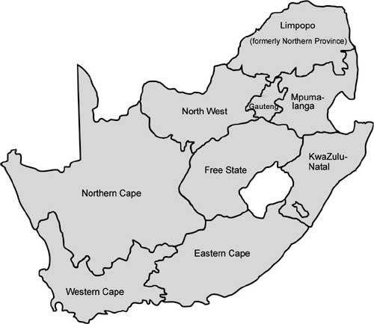
V-NAMA partners on national, provincial and municipal level
(Ekurhuleni)
(Mogale)
Randfontein
Mangaung
Majabeng
Ilembe
eThekwini
Chris Hani
Cacadu Nelson Mandela Bay

Slide 16
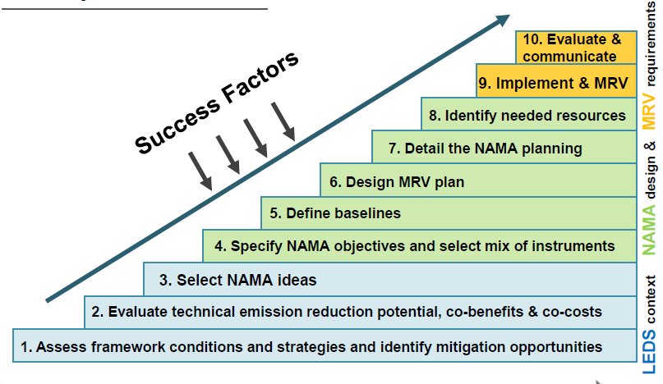
GIZ NAMA Tool – 10 steps to a NAMA
http://mitigationpartnership.net/sites/default/files/nama_tool_9.0_0.pdf

Slide 17
Step 1 and 2: framework conditions / mitigation opportunities and potential, co-benefits
Baseline study

Slide 18
Step 3: Select NAMA ideas
Private
buildings
Public
buildings
Energy Effciency Demand Side Management Mitigation Flagship (1 out of 8):
Low-income housing,
Building codes for commercial and residential buildings,
Public
buildings
national
provincial
municipal

Slide 19
Step 3: Select NAMA ideas
Scope
Office buildings
Schools
Hospitals
Police/Fire Station
Other…
New buildings
Local and provincial level
Central level
Focus
Capacity building
Infrastructure investment
Policy level activity
Other…
Train the users
Lighting
ESCO modality
Train the managers
HVAC
Funding/Granta
Train the trainers
(Water) heating
EE regulation
4 Provinces
1 Province
Nationwide, preselection of candidates by…
Localization
All Munics
Selected Munics
…Capacity
…Ownership
1 A, 1 B, 1 C
1 big as mentor for smaller
…Visibility
…Alignment

Slide 20
Step 3: Select NAMA ideas
Private
buildings
Public
buildings
national
provincial
municipal
V-NAMA sample:
80 selected pilot buildings in 4 provinces / 10 pilot munics

Slide 21
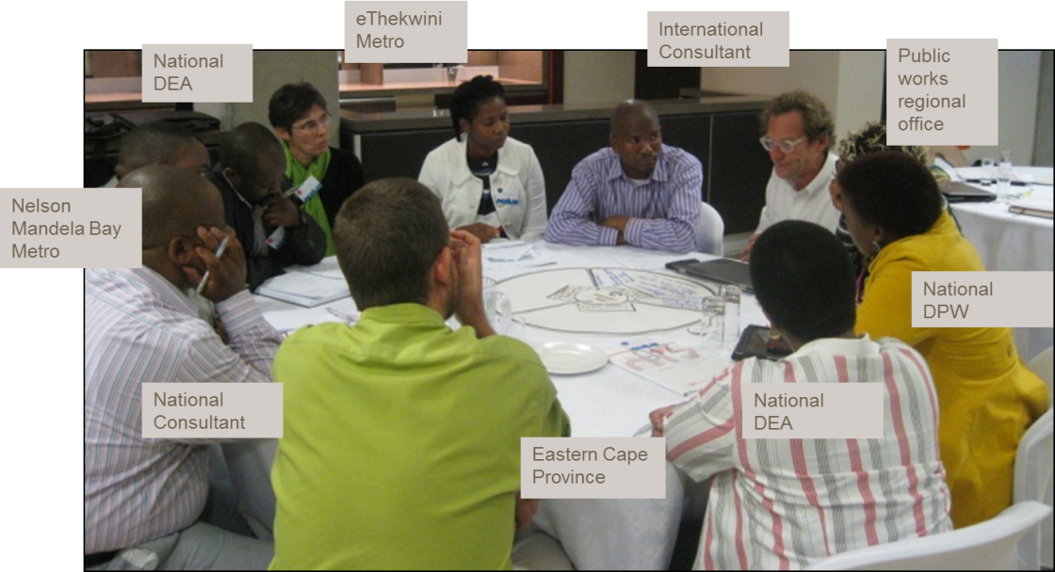
Step 4: Specify NAMA objectives and select mix of instruments
Stakeholder Workshop

Slide 22
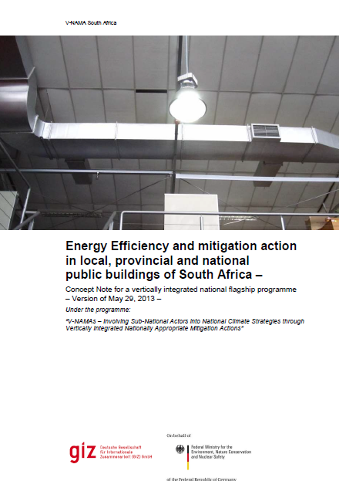
Step 4: Specify NAMA objectives and select mix of instruments
Concept Note

Slide 23
Step 5-8: Baseline, MRV-plan, detailed NAMA planning, identify resources – key outputs 2014
Elaboration of the individual elements of a v-NAMA (baseline, business-as-usual scenario, mitigation options, abatement costs, co-benefits, risk assessment, incentives, plan of action, MRV)
Elaboration of implementation and financing approaches (financing sources and mechanisms, burden-sharing, etc.)
Support for this process by means of national multi- stakeholder dialogues and capacity-building measures

Slide 24
Step 9: Implement and MRV
Private
buildings
EEDSM programme (EE grants for municipalities)
600 Mio. Rand / 40 Mio. € (2012-15), but:
Limited number of applying munics
Small fraction of budget being spent
ESCO shared savings model (for provincial and municipal buildings)
In theory self-sustaining concept, but:
Regulatory barriers for contract establishment
Ringfencing of savings unclear
Public
buildings
national
provincial
municipal
V-NAMA project:
80 selected pilot buildings in 4 provinces / 10 pilot munics

Slide 25
Subnational Involvement: Steering Structure
National
Level
Existing National Intergovernmental Task Team on Energy Efficiency
V-NAMA Sub-Working Group
(DEA, DOE, DPW + Sub-National Representatives)
Sub-National V-NAMA Steering
Commitees
Eastern Cape + Munics
Free State + Munics
Gauteng + Munics
KZN + Munics
Each led by one „champion“

Slide 26
Conclusion: What are lessons learnt from the V-NAMA on Energy Efficiency in Public Buildings?
A well-structured step-by-step approach is very helpfu!l
Don‘t be afraid of a lengthy preparation period, but prepare for it:
It‘s well invested time, because is simplifies implementation later on!
It‘s challenging time, because partners have to be kept motivated!
Sustainable development (co-)benefits are extremly important!
Vertical integration is necessary, if you want a operational business model!
MRV: keep it simple!
Last but not least:
V-NAMA approach is very well received by the South African partners

Slide 27
South Africa Delegation at the COP 2013 (ADP Workshop on Urbanization)
‘’South Africa wants to strongly support the call to launch a process in Warsaw that will conclude in Paris in 2015 with a local climate action plan for local governments that is supported by specific sustainable urban development windows within global climate finance mechanisms, and where the vertical integration of local climate action at the national level is ensured, for example, by (…) supporting the implementation of vertical NAMAs.
It is also necessary to establish a mechanism of regular dialogue and consultation between the Parties and the Local Government and Municipal Authorities Constituency (...)”
Quelle: http://unfccc4.meta-fusion.com/kongresse/cop19/templ/play.php?id_kongresssession=6921&theme=unfccc
Notes:
Full text:
‘’South Africa wants to strongly support the call to launch a process in Warsaw that will conclude in Paris in 2015 with a local climate action plan for local governments that is supported by specific sustainable urban development windows within global climate finance mechanisms, and where the vertical integration of local climate action at the national level is ensured, for example, by requiring that the development of National Adaptation Plans is informed by Local Adaptation Plans, and by supporting the implementation of vertical NAMAs.
It is also necessary to establish a mechanism of regular dialogue and consultation between the Parties and the Local Government and Municipal Authorities Constituency in order to ensure the input of sub-national governments into the ADP negotiations.’ (...)”

