Slide 1
Simplified modalities for demostration additionality to EE and RE projects: Approach to demostrate additionality in micro scale projects in Peru
Ministry of Environment
Peruvian DNA

Slide 2
General Overview of CDM
Carbon Assets: Economical Incentive for emission reduction projects .
Technology transfer : non conventional RE technologies.
Co-benefits.
Supports energy policies and Low carbon development strategy.
But
Regional Distribution: LDCs and poor communities
Energy efficiency among households, service sector, renewable for end users, transportation, much untouched.
Additionality: Complex regulatory structures
REFORM OF CDM

Slide 3
Recent regulatory developments in CDM : Micro scale additionality
The CDM Executive Board (EB63), upgraded the Guidelines for Demonstrating Additionality of Micro-scale Project Activities
The guidelines are likely to promote microscale project development by removing a barrier of additionality demonstration or reducing review/rejection related to its process.

Slide 4
Approach to demostrate additionality in micro scale projects
Renewable energy projects up to 5 megawatts (MW), energy efficiency projects resulting below 20 gigawatt-hour (GWh) savings per year, and Type III projects that reduce emissions by less than 20,000 tCO2eper year can now use a more simplified approach to demonstrate additionality under CDM.
This is an important milestone as it removes a significant barrier to develop high-quality but small-scale CDM projects.

Slide 5
Micro-scale additionality criteria (Type I)
For Renewable up to 5MW:
The projects are automatically additional if only one of the following conditions applies:
In Least Developed Countries, Small Island Countries or in a special underdeveloped zone of the host country identified by the government before 28 May 2010; (type I, II and III)
Off‐grid projects supplying electricity to households, communities or Small and Medium sized Enterprises (SMEs) (type I)
Distributed energy generation with subsystems under 1500 kW and end users being households, communities or SMEs (type I)

Slide 6
Micro-scale additionality criteria (Type I)
The project activity use specific renewable energy technologies/measures recommended by the host country designated national authority (DNA): technology that contributes less than 5% to the national annual electricity generation (type I) “Possitive List”

Slide 7
DNA: Communication procedure for speciic renewable technologies measures
Procedure for submission and consideration of microscale renewable energy technologies for automatic additionality.
Communicate the EB about the technologies that contribute less than <5% to national electricity generation.
F-CDM-PRT : Proposed specific renewable technologies/measures submission form (version 01.0)

Slide 8
Peruvian DNA Submission
The Renewable Energy Law, Decree 1002, that defines (i) biomass, (ii) wind, (iii) solar (iv) geothermal (v) tidal and (vi) hydro power plants that do no excedd an installed capacity of 20 MW.
Request Official information to COES (Peruvian Energy Operator) on RE technologies and installed capacity connected to the grid

Slide 9
Peruvian DNA Submission
The Peruvian DNA requests that Renewable Energy Resource (RER) projects under 5 MW be considered additional.
Peruvian DNA indicated that no power plants under 5 MW using biomass, wind, solar, geothermal, or tidal energy are connected to the Peruvian electricity grid and that the 5 MW and under hydro power plants connected to the grid represent only about 0.3% of generation.
Letter submitted October 29th,2010

Slide 10
Peruvian DNA Submission
Letter submitted by MINAM to EB: October 29th,2010
Procedure for submission and consideration of microescale renewable energy technologies for automatic additionality (v.1.0): November 25th,2011 (EB 65 Annex 3)

Slide 11
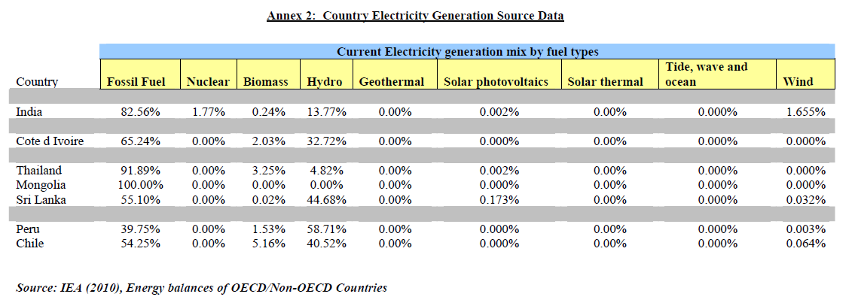
Peruvian DNA Submission

Slide 12
DNA role
Improve communication process between DNA / EB.
Follow up communication process and approval
Capacity building on micro scale procedures among project participants and stakeholders.

Slide 13
Possible impacts of micro escale projects approach
Transaction costs (validation /verification)
time reduction in validation and registration process (fast track ?)
Increase of Micro scale Projects vs PoA
Monitoring process for CPAs … sampling cost

Slide 14
Foto: La Verdad Incómoda; 2006.
Thank you

